Slide 1
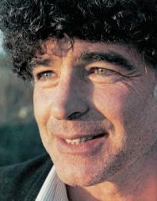
Meir search project
Applying IR and NLP algorithms on Meir Ariel songs corpus

Slide 2
Data

Slide 3
Data
Songs in plain .txt format
Crawled automatically from web
Some needed translation….. Translated automatically?

Slide 4
High level Architecture

Slide 5

Microservices
FE
BE
Search
Crawler

Slide 6
Front Microservice

Slide 7
Backend Microservice

Slide 8
Search Microservice

Slide 9
Modules design

Slide 10
Compressor
Stemmer
V-byte
Delta
Porter
D1
D2
Indexer
Tokenizer(stops)
…
DN
Positional
Keyword
Standard
NGRAM
UAX
EDGE-NGRAM
Manager
Q1
Query Processor
Q2
Search Model
Query
…
Full text
Boolean
Boolean
Ranked
QN
Phrase
Optimizer
Not implemented yet

Slide 11
Classes / Objects

Slide 12
Positional index
Location of the words in the document are important predictor of relevance
Term
Posting
T1, 103
1, 6
2, 3
….
T1 with df 103
Occurs 6 times in d1 at positions….
Hash Table
T2, 55
[7, 18, 33,…]
[1, 17, 74]
….
….
Term:
Df // #d which t occurs in
posting_list
Get_idf(term)
Posting:
ID
Tf // #t occurs in this-D (raw counts)
Tf-idf // not changeable after indeX
pos_list // position of tkns
DF(t) is #docs in which t occurs
CF(t) is #occurrences of t in the collection
DF <= CF
“T1”

Slide 13
Positional index
Index:
Tokenizer
Index = build(path)
+ build(path)
+ get_tfidf()
+ get_num_of_docs()

Slide 14
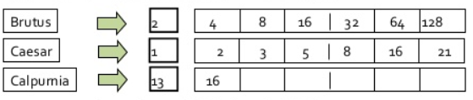
Boolean Search
Search:
Index
+ Search(Query) : list
BooleanSearch:
+ Search(BoolQuery) : list
QueryProcessor(query):
Query
Optimize_query()
+ to_query: BoolQuery
PhraseSearch:
+ Search(PhraseQuery) : list
Query:
+ is_empty()
BoolQuery:
Must
Must_not
Should
PhraseQuery:
Terms
Slop (“near operator”)

Slide 15
Vector Space Search
Search:
Index
+ Search(Query) : list
VectorSearch:
+ Search(Query) : list
Starting a search query – tf-Idf mapping will be calculated from given index to pick best match.

Slide 16
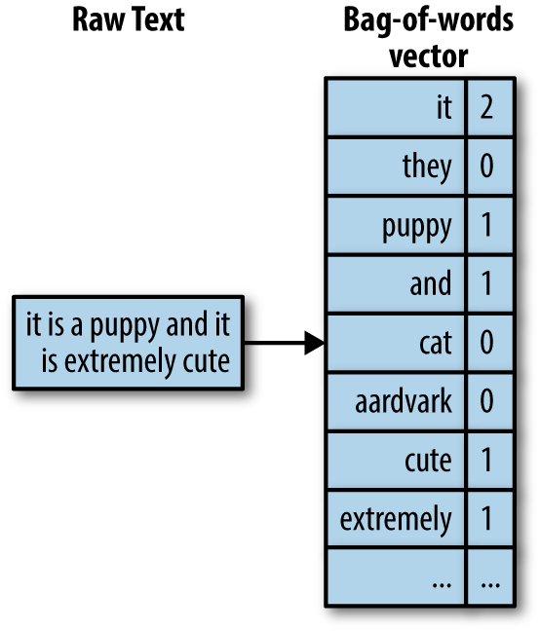
Ranked Retrieval
We are interested in solving Score(q, d) and the question on how to vectorize our text.
We’ll use BoW model: not considering order of words in a document but it frequency. <john is quicker than mary> == <mary is quicker than john>
Rare terms in a collection are more informative than frequent items. A document containing a rare term is very likely to be relevant to it. But it’s not a 100% indicator.
tf(t,d) == #times term T appeared in doc D. tf grows > importance should grow. Documents about sports contains “football” more than others.
df(t) = #documents term t appeared in. df grows > importance should decrease. “the” appears in many documents -> not important.
Relevance of document does not increase proportionally with TF. If t1 occurred 10x times in docA but 1x time in docB, it is not 10x more relevant.
Wt,d = { 1 + log tf if tf>0, else: 0} adding 1 cause log(tf==1)=log(1)==0. distinguishing from tf=0, tf=1. using LOG on TF we get same ‘יחסים’ if t1 occurs 10times and t2 occurred 20times. But t3 occurred 1mil times and t4 2mil. Log(1mil)==19.9 0->0, 1->1, 2->1.3, 10->2, 1000->4.

Slide 17
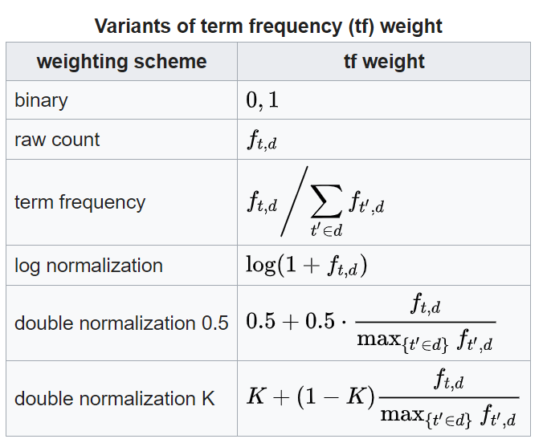
TF
In the case of the term frequency- the simplest choice is to use the raw count of a term in a document.
Ideally – we would want to normalize our TF, as we could have differences in results, (it depends on our model or what we want to achieve) comparing D1-D2 then comparing D1-D3. if |D2| >> |D1|, this should affect our results.
We can use other possibilities (see figure) we’ll choose LOG NORMALIZATION.
Elasticsearch uses sqrt(frequency). Normalizing with sqrt lowers the differences. sqrt(81)=9, sqrt(9)=3. dampens the differences.

Slide 18
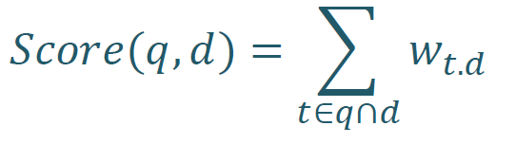
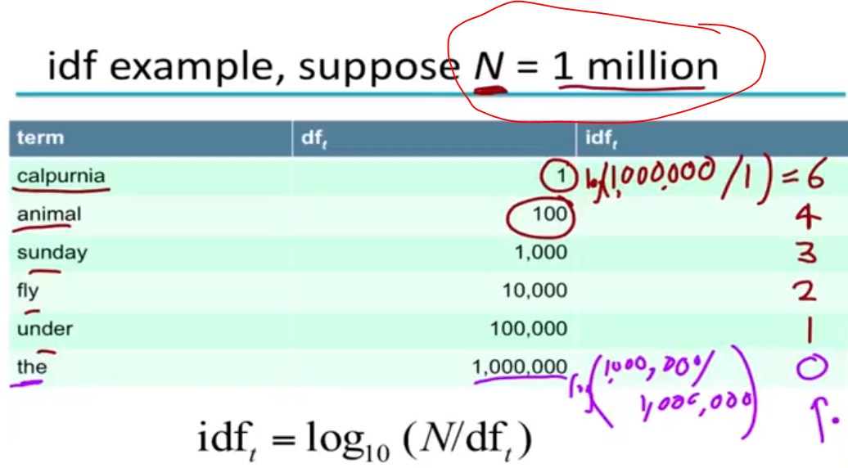
IDFT
score(q,d). we take the intersection of terms in Query and DOC as other terms won’t contribute to the score.
For a better indicator regarding frequency – we want to give higher/lower weights depends on frequencies. We will use DF for this. It’s INVERSE MEASURE of the informativeness of t. the bigger DF -> the less informative/relevance it is. DF<NumOfDocsInCollection
idfT = log(N/ (df+1)) (N==numOfDocs, adding 1 to df to ignore dividing by 0) --- value from 1…N. log will make the idf softer. Then bigger idf(t) ->rare->more important->Measures the informativeness of a term.
IDF has no effect on ranking ONE-TERM-QUERIES. Effects only with more-than-1-term. Why??

Slide 19
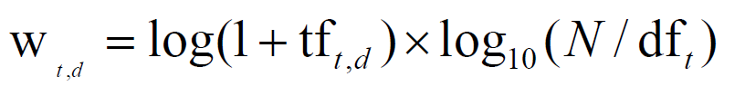
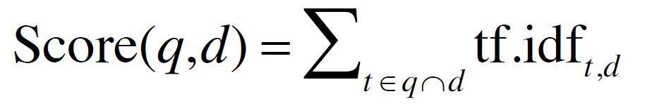
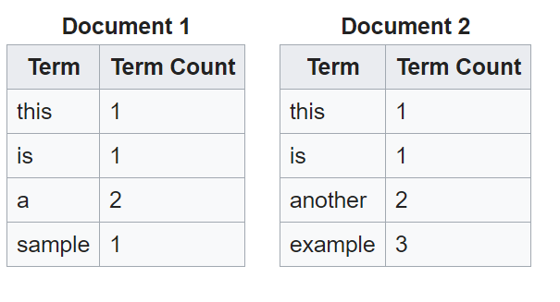
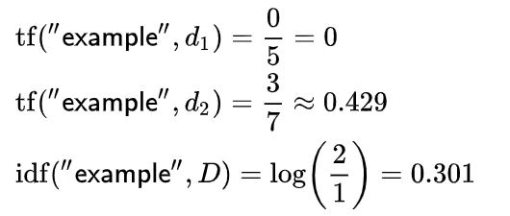
TF-IDF
Concluding both we get to tf-idf weighting:
Increases with #occurrences (tf) + rarity of terms (idf)
Example below is just tf==raw count and not tf==log(1+tf)

Slide 20
TODO

Slide 21
TODO
Algorithms:
UI:
Think on user Interface / UX ----- draw some example

Slide 22
Measurements of search engine

Slide 23
Benchmarking

Slide 24
Lekahim!

Slide 25
Project lekahim
Design!!! >>> Specs first!

Slide 26
Writings….

Slide 27
D1
Song song of agony, ebbs and flows
[song, song, agony, ebbs, flows]
D2
I'm in luck, I can sing it now.
[i’m, in, luck, can, sing, now]
Tokenization
D3
Song of agony, back again,
Stop words and punctuation removal
[song, agony, back, again]
D4
So I'll sing it now in aid.
[sing, now, aid]

Slide 28
The forward index
Transpose and construction
The Inverted index
Matrix with rows (docs) and cols (words) with
entries as frequency
Zip’s law leads to sparseness, mostly 0’s,
Construct a sparse representation
 | D1 | D2 | D3 | D4
song | 2 | 0 | 1 | 0
agony | 1 | 0 | 1 | 0
ebbs | 1 | 0 | 0 | 0
flows | 1 | 0 | 0 | 0
…
aid | 0 | 0 | 0 | 1
 | song | agony | ebbs | flows | ….. | aid
D1 | 2 | 1 | 1 | 1 |  | 0
D2 | 0 | 0 | 0 | 0 |  | 0
D3 | 1 | 1 | 0 | 0 |  | 0
D4 | 0 | 0 | 0 | 0 |  | 1
The Frequency Index
Store (id, freq) tuples sorted by ID
song
1:2
3:1
Hashtable
agony
1:1
3:1
In memory
ebbs
1:1
On disk
….
….

